Slide 1
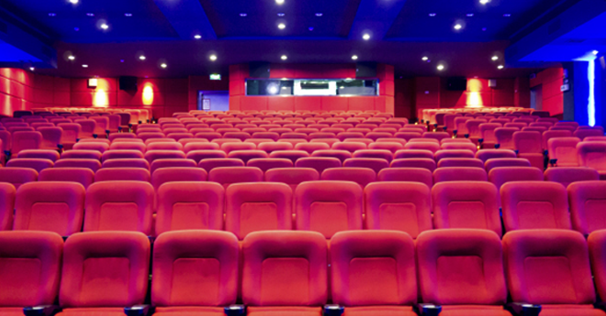
영화 좌석 예매 프로그램 화면 설계서 양식
김사과
2023.03.28

Slide 2
User flow
2
START
Process
Process
Process
Process
Process
END
Process
NO
logic
YES
Process
Process
Process
Process
Process
Process
NO
Process
logic
Process
Process
Connect
YES
Process
Connect

Slide 3
User flow
3
Login User flow | 1 STEP. Process name. | 2 STEP. Process name. | 3 STEP. Process name. | 4 STEP. Process name.
START
Process
Process
Process
Process
Process
Process
END
Process
logic
NO
YES
Process
Process
Process
logic
NO
Process
Process
YES
Process
Process
Process
Process
Connect
Connect

Slide 4


Logic process
Start
Connect
OOOO Page
Input Information
-
-
-
Input
OOOO Page
Input Information
-
-
-
-
Input
NO
End
judgment
OOOO OO OOOO OO OO
OOOOO OO OOO
YES
Input Information
-
-
-
Process
Process
확인
NO
OOOO Page
judgment
OOOO DB
NO
NO
Process
judgment
judgment
Input Information
-
-
-
YES
YES
DB
connect
OOOO DB

Slide 6
6
Summery.
Summery에는 해당 페이지와 관련된 요약사항을 정리해주세요. Content_#001 Content_#002 Content_#003
1
2
3
4
5
6
7

